Slide 1

Partner Sponsor

Slide 2





Gold Sponsors

Slide 3



Silver Sponsors
Community Sponsors

Slide 4


Integrating Kubernetes & Azure
Sam Cogan
Solution Architect, Willis Towers Watson & Microsoft MVP

Slide 5




About Me
Sam Cogan
Solution Architect – Willis Towers Watson
Microsoft Azure MVP
samcogan.com
@samcogan
sam-cogan

Slide 6










Slide 7
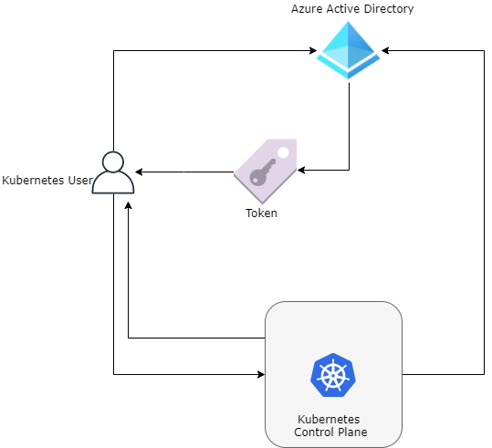
Azure AD Integration

Slide 8
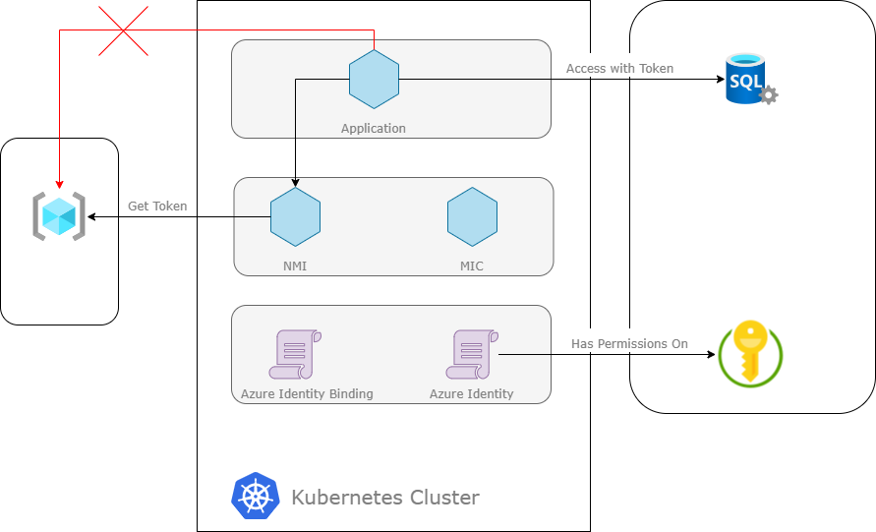
Pod Identity

Slide 9
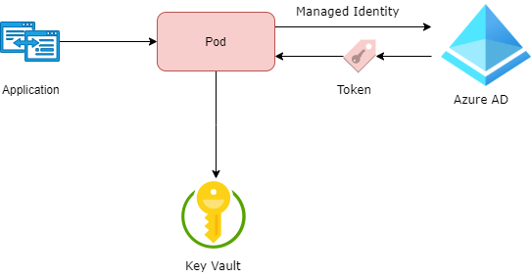
Key Vault
Key Vault Flex Volume - https://github.com/Azure/kubernetes-keyvault-flexvol
Key Vault to Kubernetes - https://github.com/SparebankenVest/azure-key-vault-to-kubernetes

Slide 10
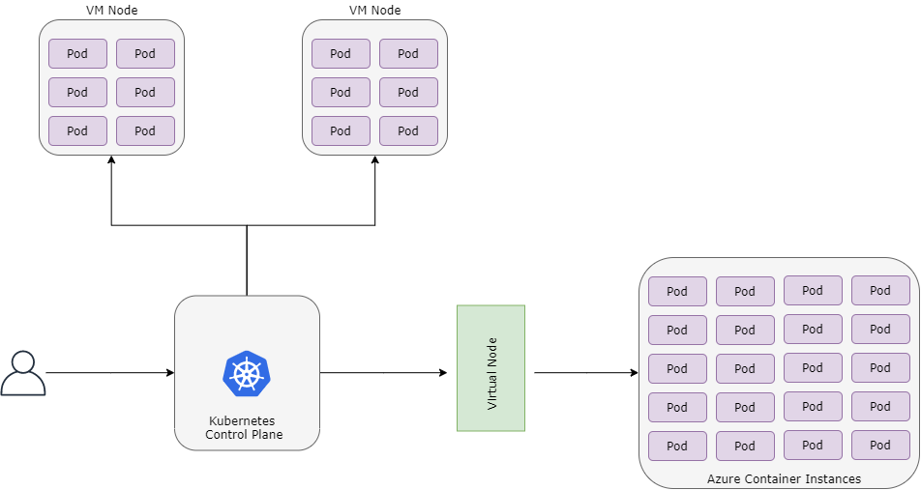
Virtual Node

Slide 11


Monitoring & Scaling
Promitor - https://promitor.io/
Keda - https://github.com/kedacore/keda

Slide 12
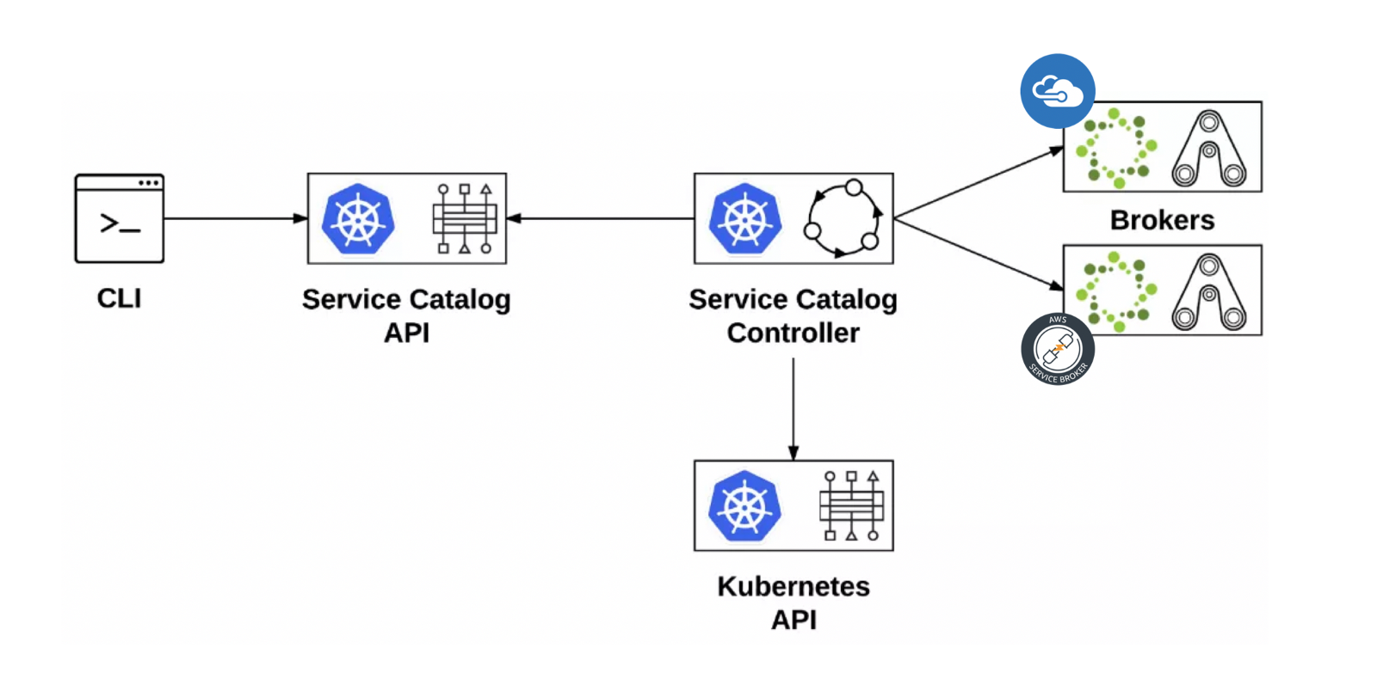
Open Service Broker for Azure

Slide 13
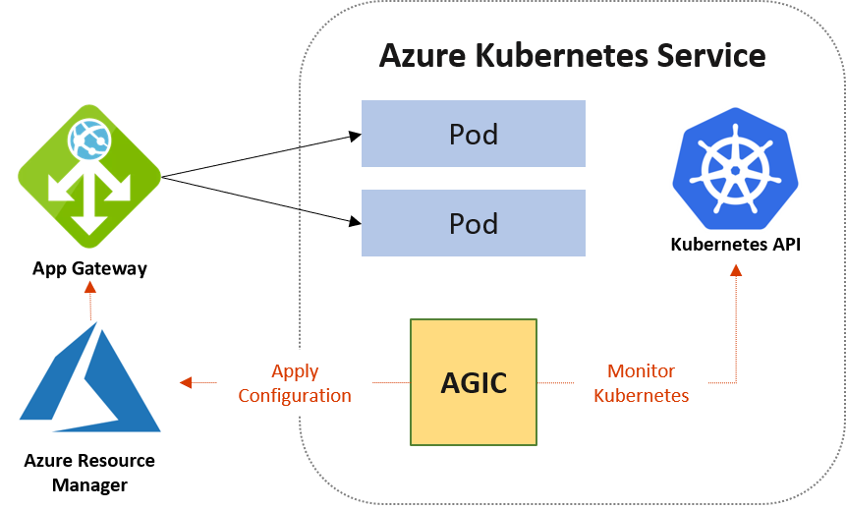
App Gateway

Slide 14
About Me
Sam Cogan
Solution Architect – Willis Towers Watson
Microsoft Azure MVP
samcogan.com
@samcogan
sam-cogan

Slide 15
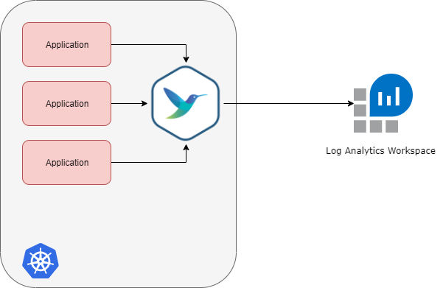
Fluent Bit Logging

Slide 16
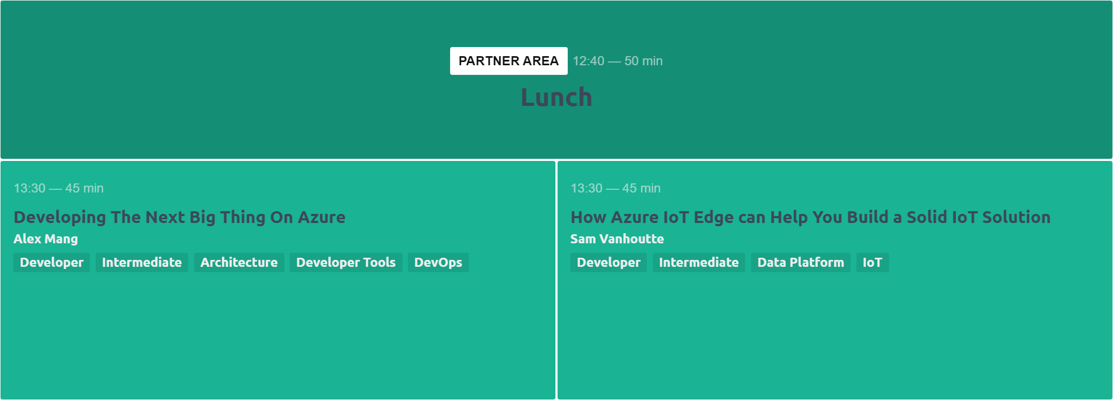
Next sessions

